Slide 1
Proposal doc for MS11
Prepared By
Sevanand Singh

Slide 2
Agenda
Dolby Technology(MS11 and MS10)
BBC CANVAS
Diff Between MS11 and MS10
Supported in STAUDLX
Modification Required for MS11
Modification Required for CANVAS

Slide 3
Dolby Technology(MS10 and MS11)

Slide 4
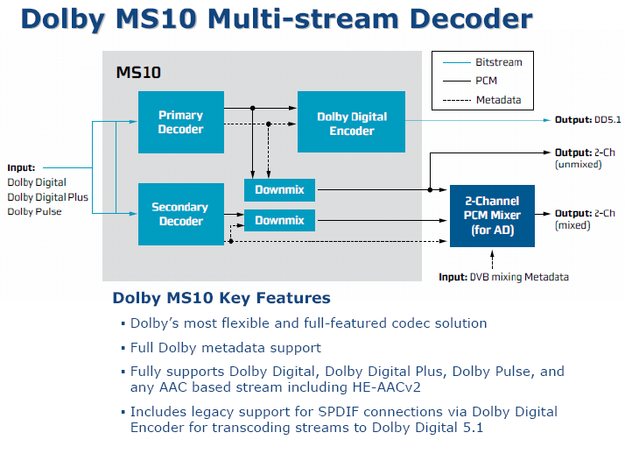

Slide 5
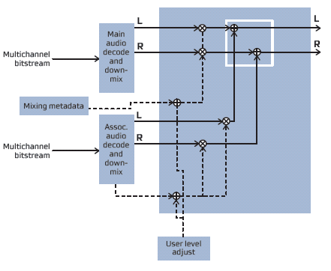
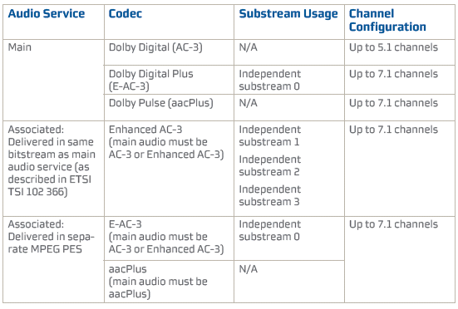
MS10 Stereo Audio Mixing

Slide 6
Dolby Technology MS11

Slide 7
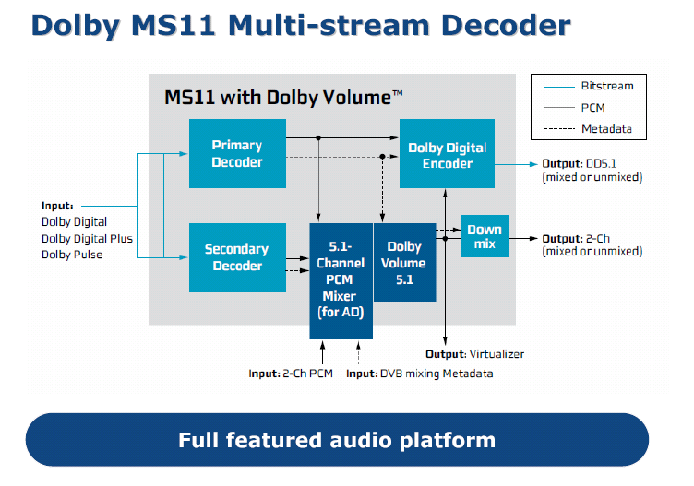

Slide 8
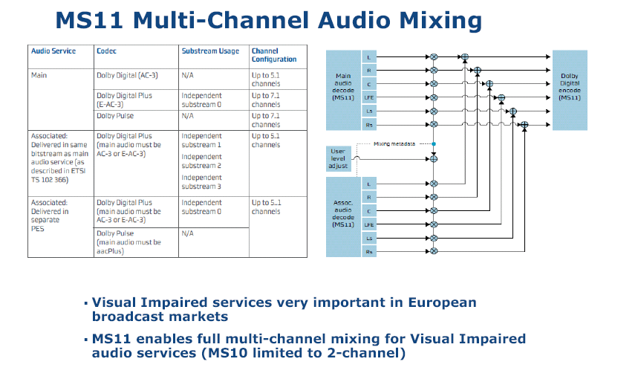

Slide 9
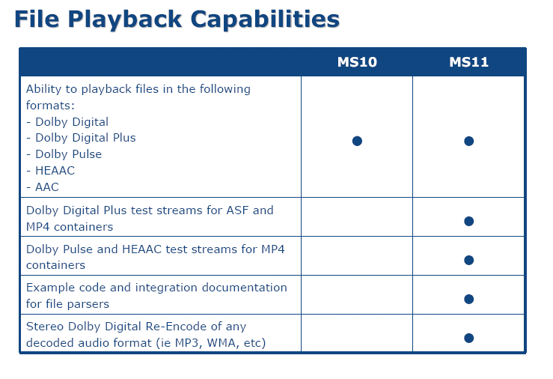

Slide 10
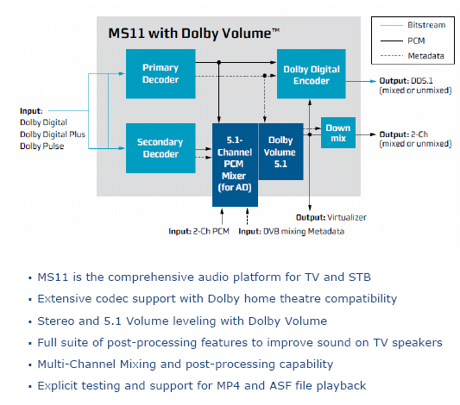

Slide 11
BBC CANVAS

Slide 12
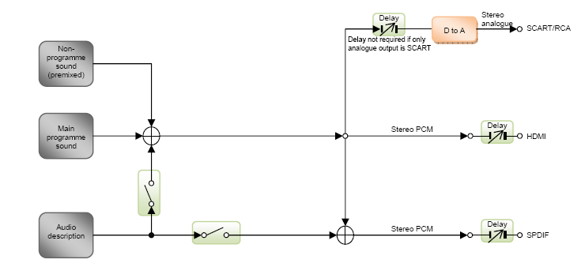
BBC CANVAS Main program Stereo Input

Slide 13
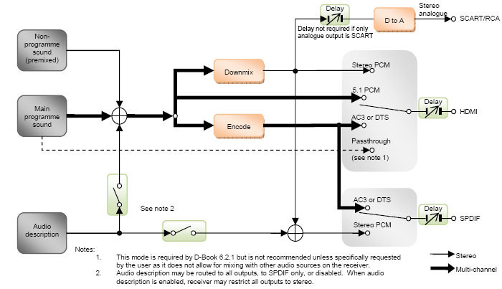
BBC CANVAS Main program Multichannel Input

Slide 14
Input Stream Type
MPEG-1 Layer II
Dolby E-AC-3
Multi-channel HE-AAC
Stereo HE-AAC and LC-AAC
Receiver-mix audio description
MPEG-1 Layer III
Note: *Non-Program Sound may generate from any source (ALSA, Extrn MP3 decoder).
*Non-Program sound is assumed to be premixer to stereo PCM.

Slide 15
Control on Audio description
Audio description disabled
Audio description mixed with all audio outputs
Audio description mixed with audio on SPDIF output
main programme sound sent to all other audio outputs without AD on PCMPlayers.

Slide 16
Diff Between MS11 and MS10

Slide 17
Diff Between MS11 and MS10
 | MS10 | MS11
Channel Supported | Stereo | MultiChannel
Sampling Freq | 32, 44.1 and 48 Transcoding supported only for 48KHz | 32, 44.1 and 48 Transcoding supported for all sampling freq's
No of Output | ByPass over HDMI, , Trancoded DD and Stereo PCM. | ByPass Over HDMI, Transcoded DD, Multichannel PCM and Stereo PCM
Transcoded Output | Transcoding will be applied at primary decoder(Before mixing) | Transcoding will be applied after mixing + DV
NOTE: DDRE tansform will produce stereo, multichannel
and Transcoded output.

Slide 18
Supported in STAUDLX

Slide 19
Generic audio driver chain for MS10
P
I
T
SPDIFF0
M
U
X
PCMP0
HDMI
Comp/PCM
PP0
M
U
X
SPDIF0
SPDIF
Comp/PCM
CD0
DEC0
PP1
MIX0
PP2
PCMP1
Analog
PCM O/P
CD1
DEC1
 | Compressed
 | Uncompressed
 | Comp/Uncomp Data
 | Temparary Connection
 | MetaData Flow

Slide 20
Implementation of MS10 in staudlx driver
Basic config:
Configure mixer in FIXED_OUTPUT_NO_SAMPLES 1 Means output no. of sample = input no. of sample.
MetaData Handling
For DD+, metadata extracted from decoder/pes header/default.
For Dolby Pulse, metadata extracted from PES header/default.
DD+ metadata are extracted from DecoderOutputCmdParam_t framestatus.
Carry these metadata to mixer module through Appdata_p field of memoryblock(for dd+) or through flag element of memoryblock.
Mixing metadata are FADE and PAN.
FADE means gain factor applied on primary input
PAN means secondary mono audio angular position in 360*

Slide 21
Implementation of MS10 in staudlx driver
Transcoded buffer:
Transcoded Dolby digital buffer is extracted from main decoder.
Transcoding is disabled for secondary decoder.
Output no. sample of primary and secondary decoder is 1536(to make transcoding possible).
DD+ to DD is handled by lx decoder. No encoder is required.
Dolby pulse to DD is done by DDCO encoder at firmware side (encoder is tightly coupled with decoder). No saparete encoder module connected.

Slide 22
Implementation of MS10 in staudlx driver
For DD+ stream, we supported multiple stream ID’s within single PID.
In this case, we internally connect CD0 output to DEC1 in STAUD_IPSetADSubStreamID.
Once user will select substream id 0 then internally we disconnect CD1 and reconfigure default connection.
DD+ parser put I0 and In block in two separate block’s of different blockmanager’s.
For Dolby Pulse stream, parsing is done by lx.

Slide 23
Modification Required for MS11

Slide 24
At Parser Module
For DD+ over HDMI compatible:
Should will not drop any data (unwanted independent substream or dependent substream or transcoded substream).
Lx parser will take care of parsing correct data and drop redundent data.
Proposed way:
* Get both memory block (wait till both are not available).
* Put required or unrequired frame into same memory block untill audio frame size of I0 will not become 1536 or consync will found.
* Copy complete memory block in second block and put both of them.
* No need to put substream ID info in block.

Slide 25
At Parser Module
For Dolby Pulse over HDMI:
?
We may take compressed frame aligned data for decoder(till now not supported by firmware).

Slide 26
At decoder Module
Buffer handling for Stereo , Multichannel and Transcoded output.
* For Stereo output, staudlx driver may use Aux channel of 10 channel buffer.
Or
* Driver may provide addition buffer to handle stereo output
For dolby pulse, Driver may ask for frame aligned compressed output for HDMI.
* Addition buffer require.
For DTS 2D, DTS encoder coefficients should be extracted in callback function and cascaded to appropriate module(Mixer/Postprocess).
Dolby Volume lite DV258

Slide 27
At mixer Module
In MS10 implementation, mixer operate in o/p no. sample = i/p no. of sample.
For MS11/CANVAS, o/p no. of sample should be fixed(to align transcoded and PCM output) i.e. :
For Dolby products 1536
For DTS products 512
Mixing Metadata should be handled according to no.of sample send for processing.
For MS10, mixing metadata are frame aligned but for MS11 frame alignment may disturb(need to clarify with dolby).
Handling for Transcoded, Stereo and multichannel output.
Dolby volume lite.
While configuring DDRE config driver should inform whether data is Dolby volume processed or not.
DTS Encoder metadata processing

Slide 28
At Post Process Module
- Buffer handling for stereo, multichannel and transcoded output.
Dolby Volume lite DV258
DTS Encoder metadata processing.

Slide 29
Use Cases

Slide 30
Single decode
PARSER
DECODER
DP HDMI Output
DD+, DD and DP
DD Transcoded o/p
Stereo PCM
MultiChannel PCM o/p
For DD+ and DD, Compressed unaltered i/p
should be taken from Parser module.
For Dolby pulse, Compressed frame aligned i/p
should be taken from decoder module.

Slide 31
Dual Decode + Mixing
DP HDMI Output
PARSER0
DEC0
DD+, DD and DP
MIXER0
DD Transcoded o/p
Stereo PCM
MultiChannel PCM o/p
DD+, DD and DP
PARSER1
DEC1
Mixing Metadata
For DP, mixing metadata are extracted for PES Header
For DD+/DD/DTS, mixing metadata are extracted from decoder

Slide 32
Thanks

